Slide 1
SMART HOME APPLIANCES
Vamshi Saini

Slide 2
CONTENTS
AIM
PROPOSED WORK
CONSTRUCTION
COMPONENTS
PROJECT MODEL
SIMULATION DIAGRAM
CODE
ADVANTAGES
DISADVANTAGES
OUTCOME
CONCLUSION

Slide 3
AIM
Aim of the project is to reduce the amount of power consumed by every household and office, which share major energy.
Nowadays, humankind is moving towards new technologies by replacing manual operations with automatically controlled devices. One of the basic requirements of the people is light and during hot weather is a cooling fan.
But, the speed of the fan can be controlled by manual operation using a manual switch, namely the fan regulator. It can be watched in some places, like where the temperature is high during the morning though the temperature falls radically at night time. The users do not understand the difference in temperature.
So, to overcome the speed of the fan, here is a solution to varying according to temperature. This concept is particularly applicable for areas where temperature changes radically during day and night time.
This project will convert the manual fan into automatic fans. And also help in controlling the light using human detection and helping in conserving energy.

Slide 4
PROPOSED WORK
This project is an Arduino-based smart home appliance it includes a temperature control electric fan and heater along with smart light which glows on detecting human motion at night. The use of embedded technology makes this closed-loop feedback control system efficient and reliable. Microcontroller (ATMega8 / 168 / 328) allows dynamic and faster control. A liquid crystal display (LCD) makes the system user-friendly. The sensed temperature and fan speed level values are simultaneously displayed on the LCD panel.
ARDUINO microcontroller is the heart of the circuit as it controls all the functions. The temperature sensor 103 Thermistor senses the temperature, PIR for human detection and LDR for night detection these inputs taken from detectors are converted into an electrical (analogue) signal, which is applied to the microcontroller.
The sensed and set values of the temperature are displayed on the 16x2-line LCD. This project is useful in process industries for maintenance and controlling of Boilers’ temperature.
It is very compact, using few components and can be implemented for several applications, including air-conditioners, water heaters, snow-melters, ovens, heat exchangers, mixers, furnaces, incubators, thermal baths and veterinary operating tables.

Slide 5
COMPONENTS
S.NO | NAME OF THE COMPONENT | QUANTITY
1. | Arduino UNO3 | 1
2. | Breadboard | 1
3. | Jumper wires | few
4. | LED | 5
5. | LDR | 1
6. | PIR | 1
7. | 103 Thermistor | 1
8. | 27k ohm resistor 10k resistor | 1 1
9. | 5V DC motor fan | 1
10. | 16x2 LCD display | 1

Slide 6
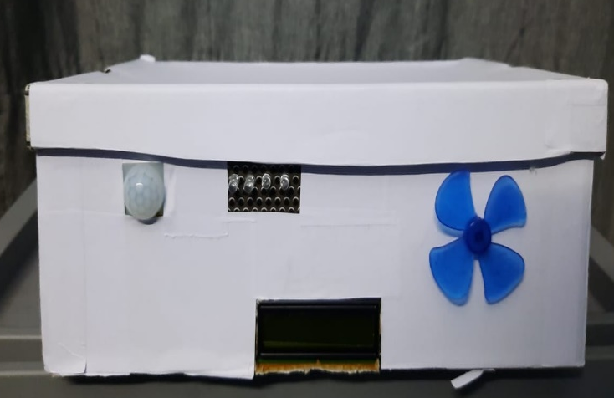
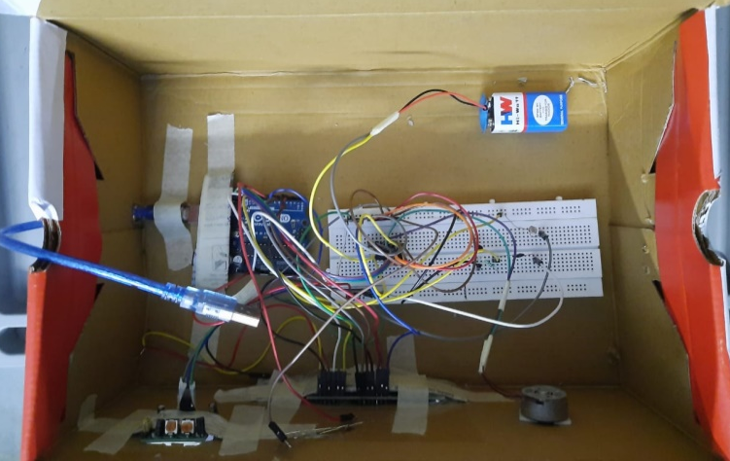
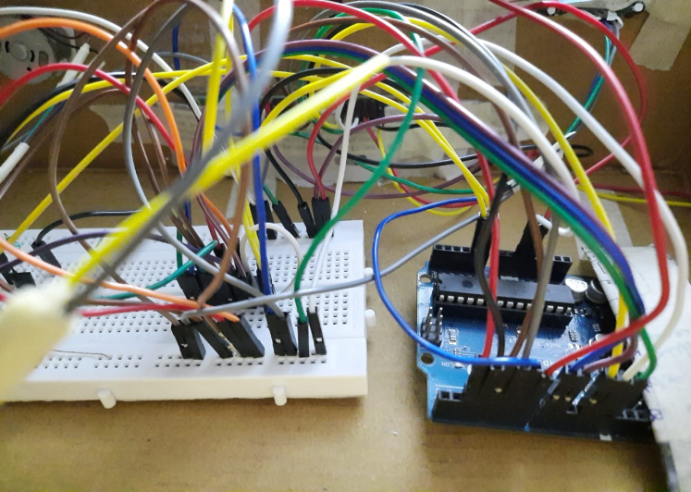
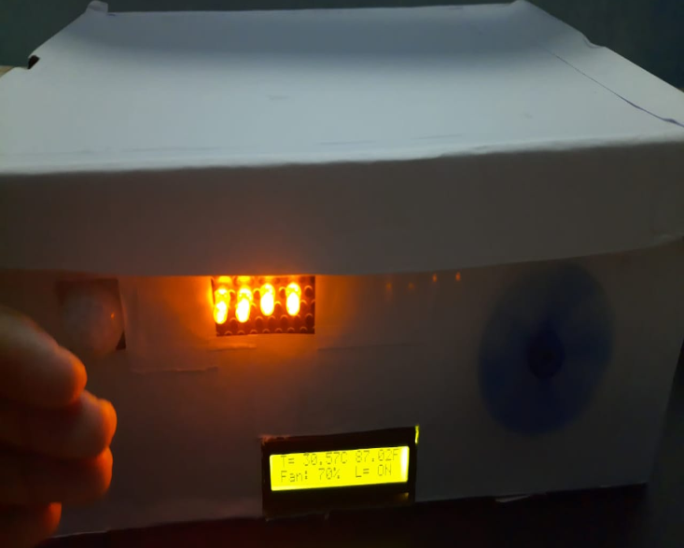
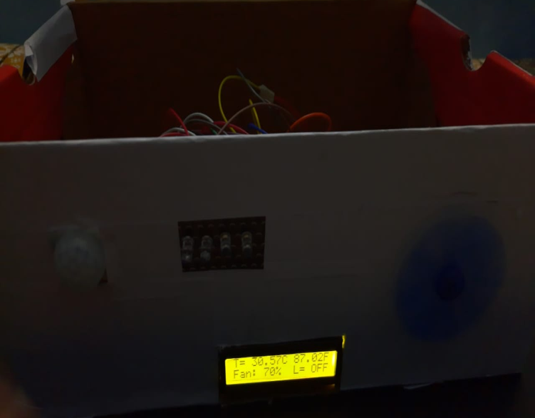
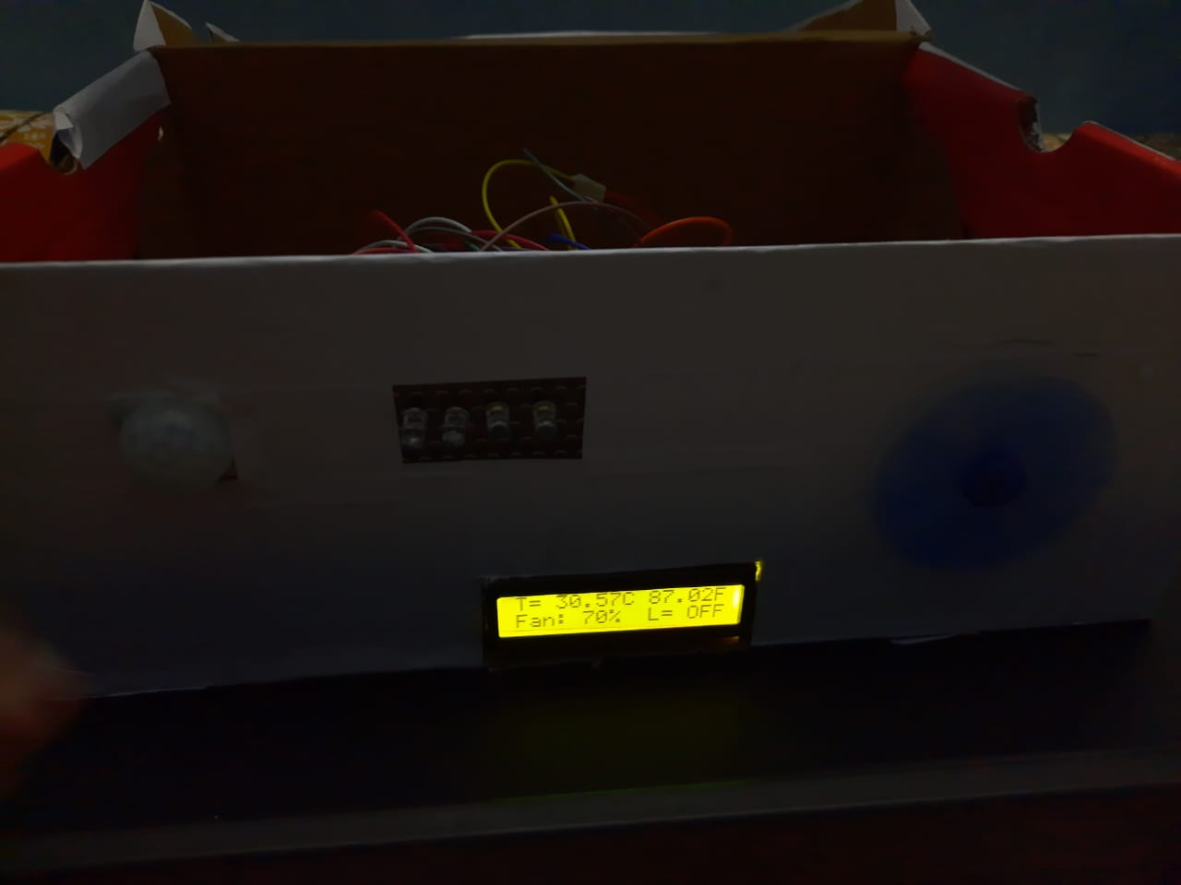
PROJECT MODEL

Slide 7
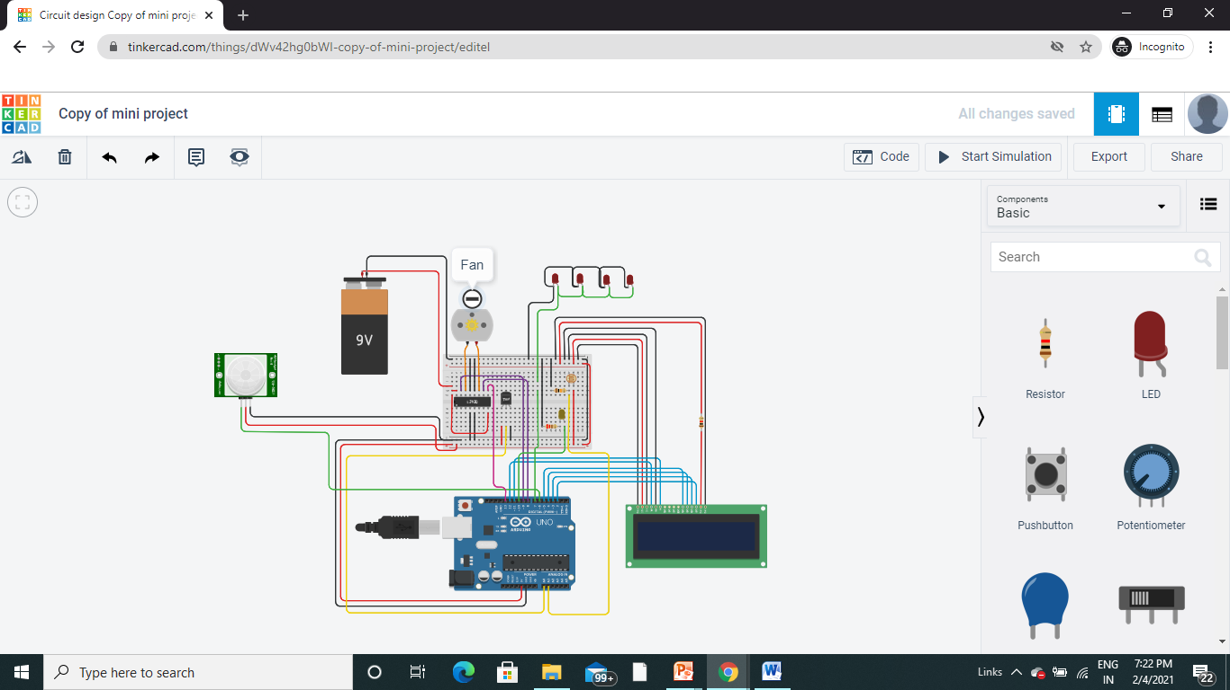
SIMULATION DIAGRAM

Slide 8
ADVANTAGES
This project can be used at Home.
This project can be used in Industry.
This will help in saving energy/electricity.
To monitor the environments that are not comfortable or possible for humans to monitor, especially for extended periods of time.
Prevents waste of energy when it’s not hot enough for a fan to be needed.
To assist people who are disabled to adjust the fan speed and turn on lights automatically.

Slide 9
DISADVANTAGES
It can only be maintained by a technical person. Thus, it becomes difficult to be maintained.
Due to temperature variation, sometimes its efficiency may decrease.
PIR works effectively in LOS (Line of Sight) and will have problems in the corner regions.

Slide 10
OUTCOME
The project aims were to monitor the environments that are not comfortable or possible for humans to monitor, especially for extended periods of time and find a solution to save power.
In this project, the first thing to do is to prepare the inputs and outputs of the system to control the lights and speed of the fan.
The prototype has been implemented and works as expected and will prove to be very useful, and will fulfil all the present constraints if implemented on a large scale.

Slide 11
CONCLUSION
The circuit is very simple and easy to build. This paper elaborates on the design and construction of fan speed and light controlled by temperature and human motion, respectively.
Moreover, the fan speed will increase automatically if the temperature increases. And the light will turn on when a human is detected during the night
In conclusion, the system which is designed in this work performs very well for any temperature change and detects the presence of humans and can be classified as automatic control.

Slide 12
THANK YOU

